Slide 1
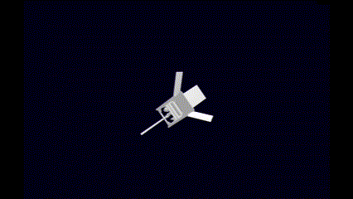
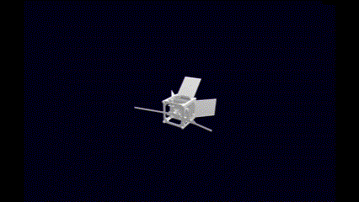
Weekly Quad Chart - 8/11
Updates
Blockers
Jetson Orin for power consumption of EKF, MEKF on different modes and frequencies
Wire AWG selection and material for Helmholtz cage
Requirements
Blockers and Requirements
Weekly Results
Studied MEKF course resources and papers
Started solving combined-estimation problem for attitude and orbit determination
Leveraging Brahe for the final sim. The python library did not support drag computation. Added local atmospheric density calculation using the NRLMSISE00 atmosphere model.
Created the visualization for a detumbling satellite using the sim.
Next week
Improve on orbit estimation by adding more complexity
Debug MEKF and study more resources
Continue solving combined estimation problem for attitude and orbit determination
Continue working on CAD design for the cage
Implement SGP4 Orbit propagation utilizing TLE data.
Weekly Results and Plan
Avionics:
Fprime development on Pycubed; Communication with Jetson for estimation
Mechanical:
Vision:
Discuss any major changes or updates to output of vision system
COMOPS:
Communication protocol & Commands
Interface dependencies

Slide 2
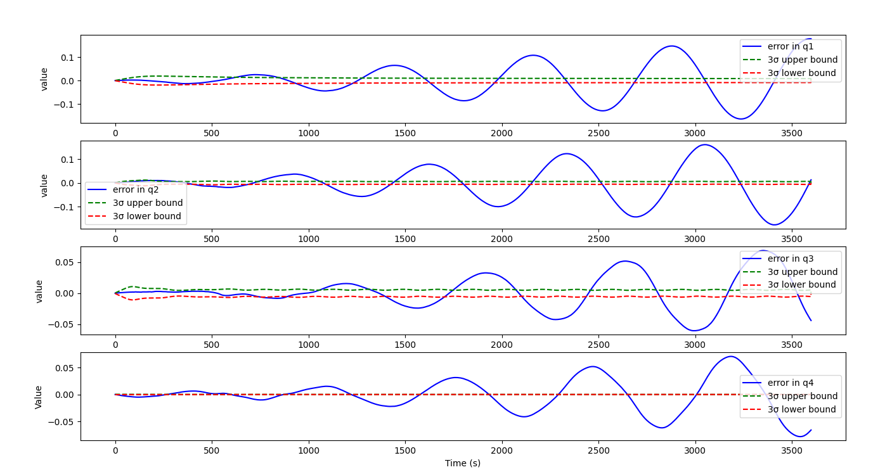
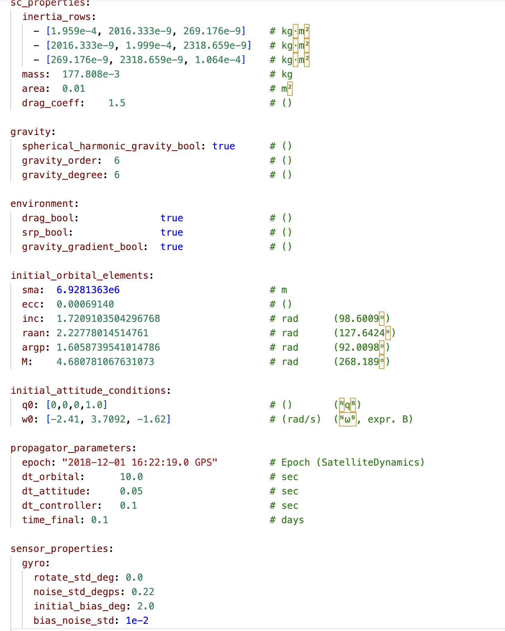
Weekly Quad Chart - 1/11
Updates
Blockers
Jetson Orin for power consumption of EKF, MEKF on different modes and frequencies
Wire AWG selection and material for Helmholtz cage
Requirements
Crash course by Zac on MEKF
Blockers and Requirements
Incorrect MEKF error plots : error builds
Sample config file for sim
Weekly Results and Plan
Avionics:
Fprime development on Pycubed; Communication with Jetson for estimation
Mechanical:
Vision:
Discuss any major changes or updates to output of vision system
COMOPS:
Communication protocol & Commands
Interface dependencies
Weekly Results
Studied MEKF course resources and papers
Implemented MEKF
Compute benchmarking on Raspberry Pi
SW Eng work for simulator
Defined modular structure for sim. Came up with yaml config file based approach for simulation configuration,initialization and runs.
Implemented config parser script and created sample config file.
Next week
Improve on orbit estimation by adding more complexity
Debug MEKF and study more resources
Generate simulated ground truth data for MEKF with angular velocity dynamics
Power analysis on Jetson
Continue finalize the cage simulation by adding wire awg information

Slide 3
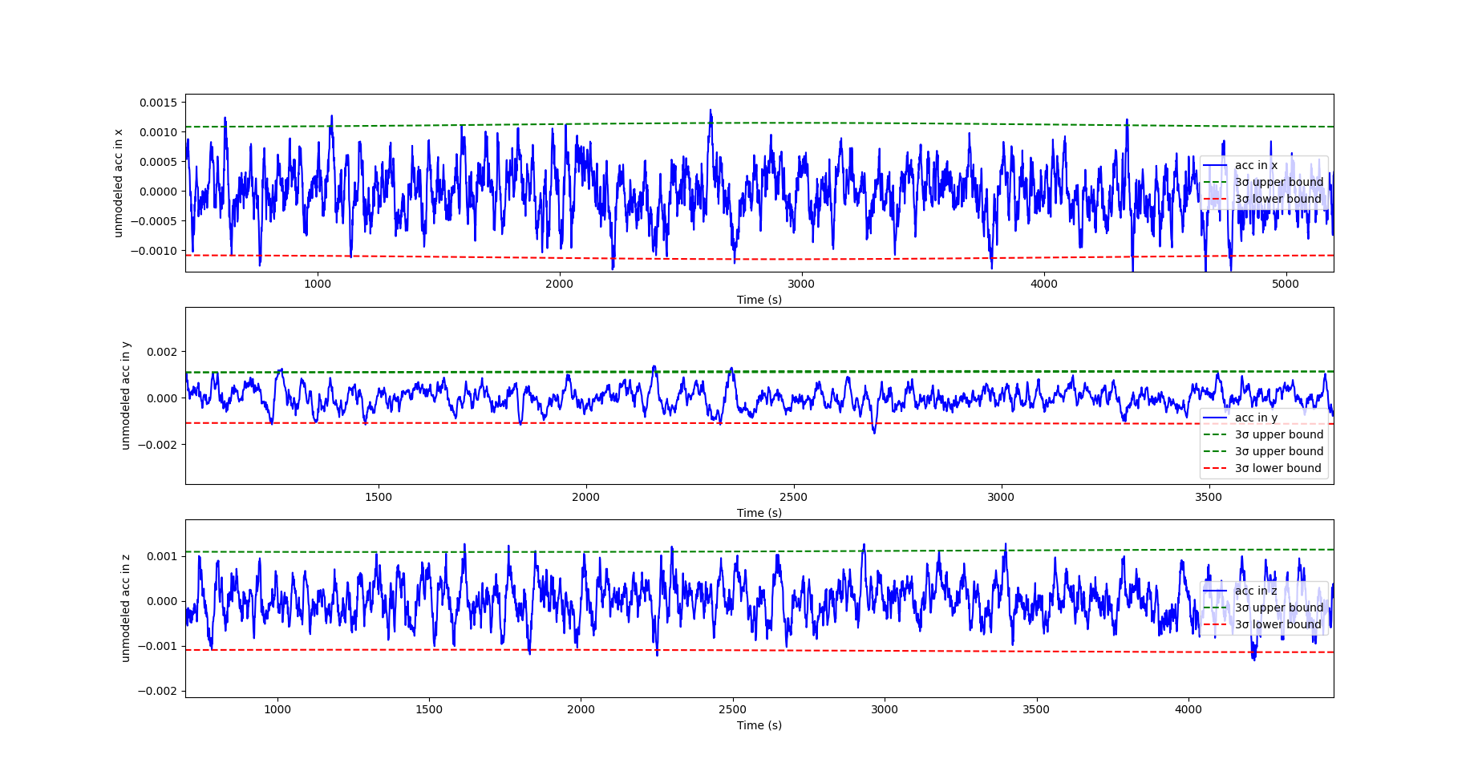
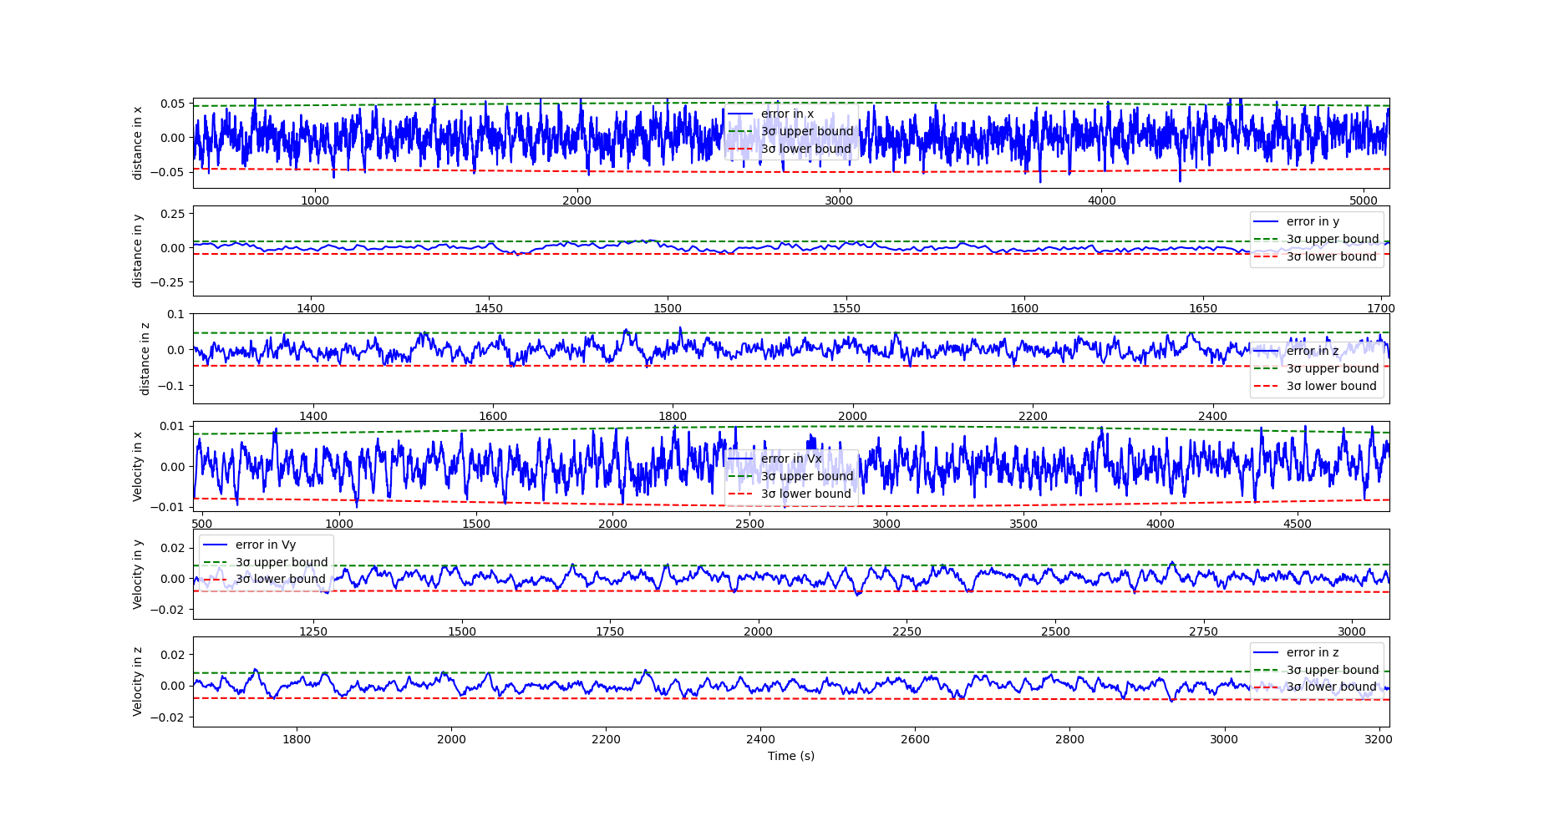
Weekly Quad Chart - 25/10
Updates
Blockers
Requirements
Crash course by Zac on MEKF
Pycubed board to start twiddling with software frameworks
Blockers and Requirements
State residuals
Unmodeled acceleration residuals
Weekly Results
Implemented EKF for orbit estimation following version 1 method
Implemented EKF for orbit estimation with unmodelled acceleration in states
Started the design of HIL devices for magnetometer, magnetorquer and sun sensor
Explored slew maneuvers using magnetorquers.
Next week
Improve on orbit estimation
Implement simple MEKF
Weekly Results and Plan
Avionics:
Finalize computer framework and sensor selections
Mechanical:
Vision:
Discuss any major changes or updates to output of vision system
COMOPS:
Communication protocol & Commands
Interface dependencies

Slide 4
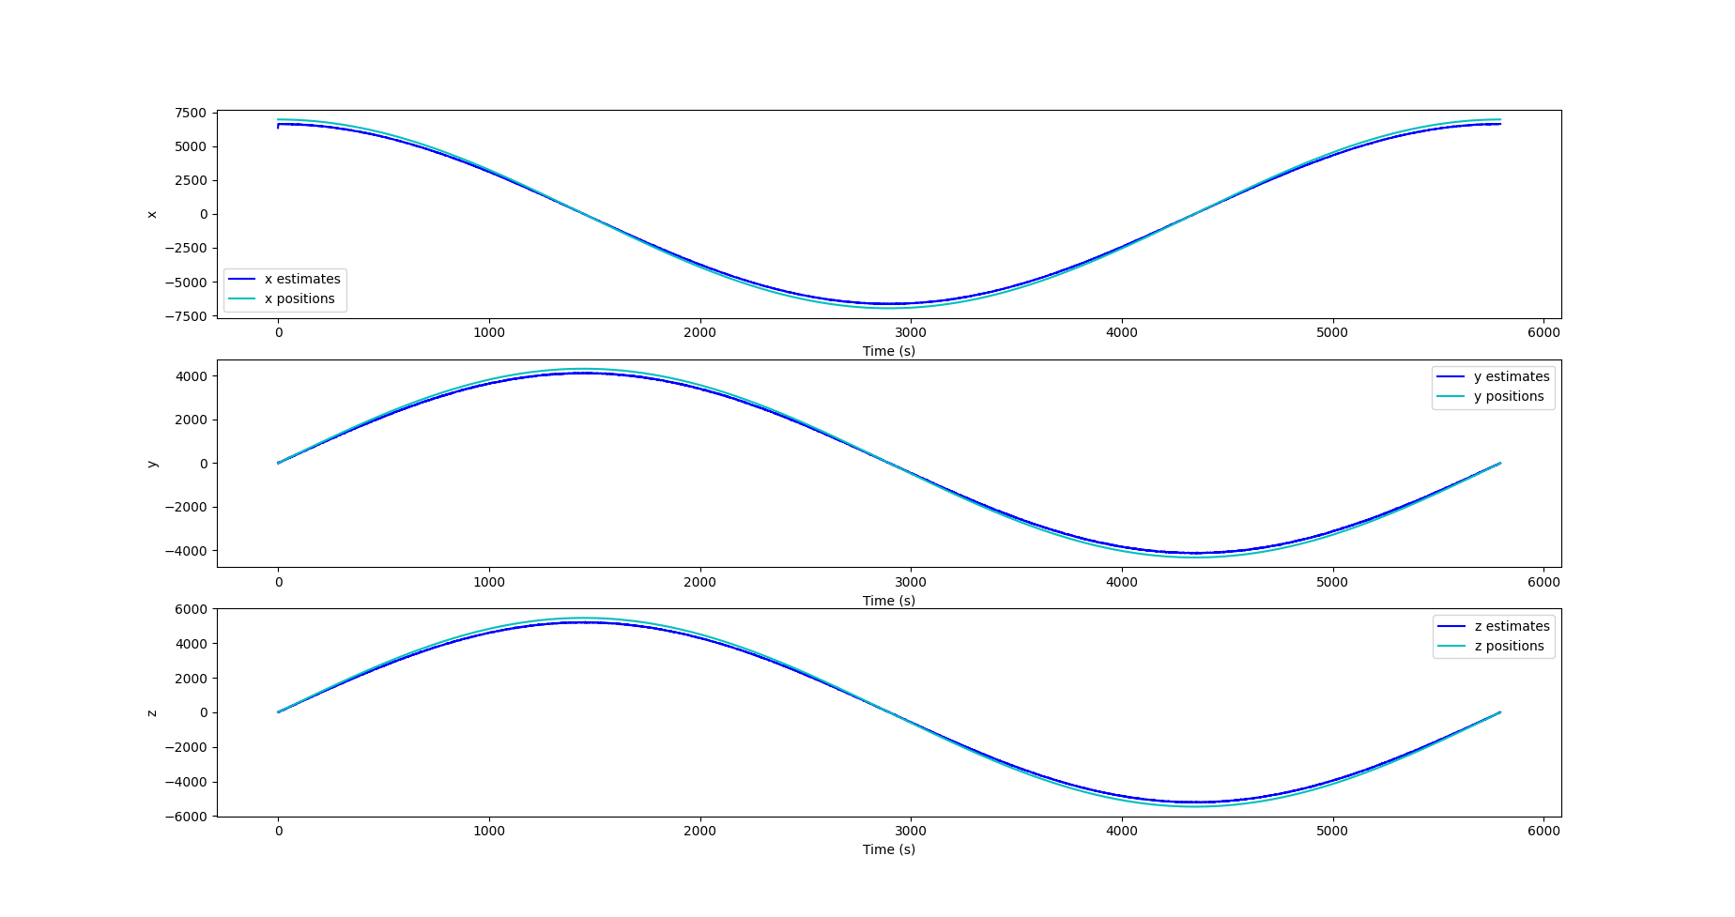
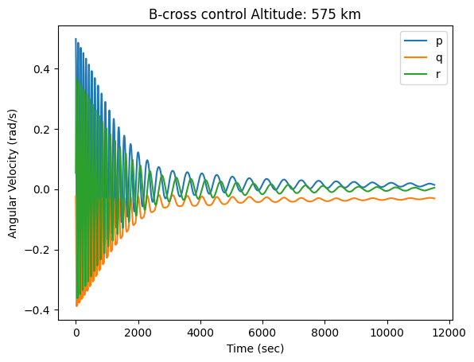
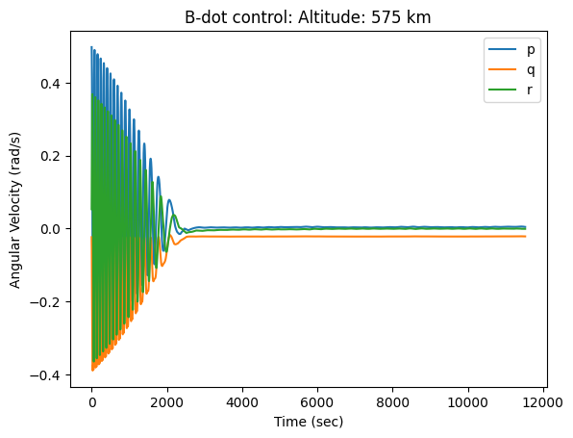
Weekly Quad Chart - 11/10
v
Updates
Blockers
Requirements
Crash course by Zac on MEKF
Pycubed board to start twiddling with software frameworks
Blockers and Requirements
B-cross control for detumbling
B-dot control for detumbling
Kalman filter for orbit estimation
Weekly Results
Implemented Kalman filter for orbit estimation
Implemented b-cross control for detumbling. Ran some experiments to compare the performance of b-dot and b-cross control
Started listing risks and potential mitigations
Fprime compatible with PyCubed board
Next week
Implement simple MEKF
Formally compare the performance of the detumbling control techniques in a Monte carlo sim.
Continue risk analysis
Basic workflow/state machine using Fprime on PyCubed
Start evaluating options for estimation architecture with vision inputs
Keep implementing more risk analysis
Weekly Results and Plan
Avionics:
Finalize computer framework and sensor selections
Mechanical:
Vision:
Discuss any major changes or updates to output of vision system
COMOPS:
Communication protocol & Commands
Interface dependencies

Slide 5
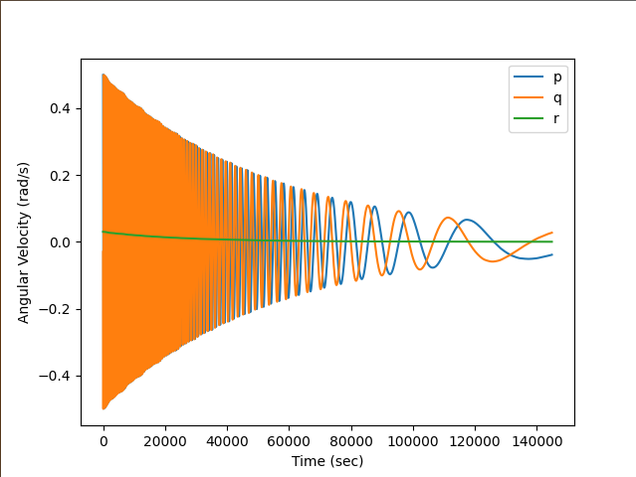
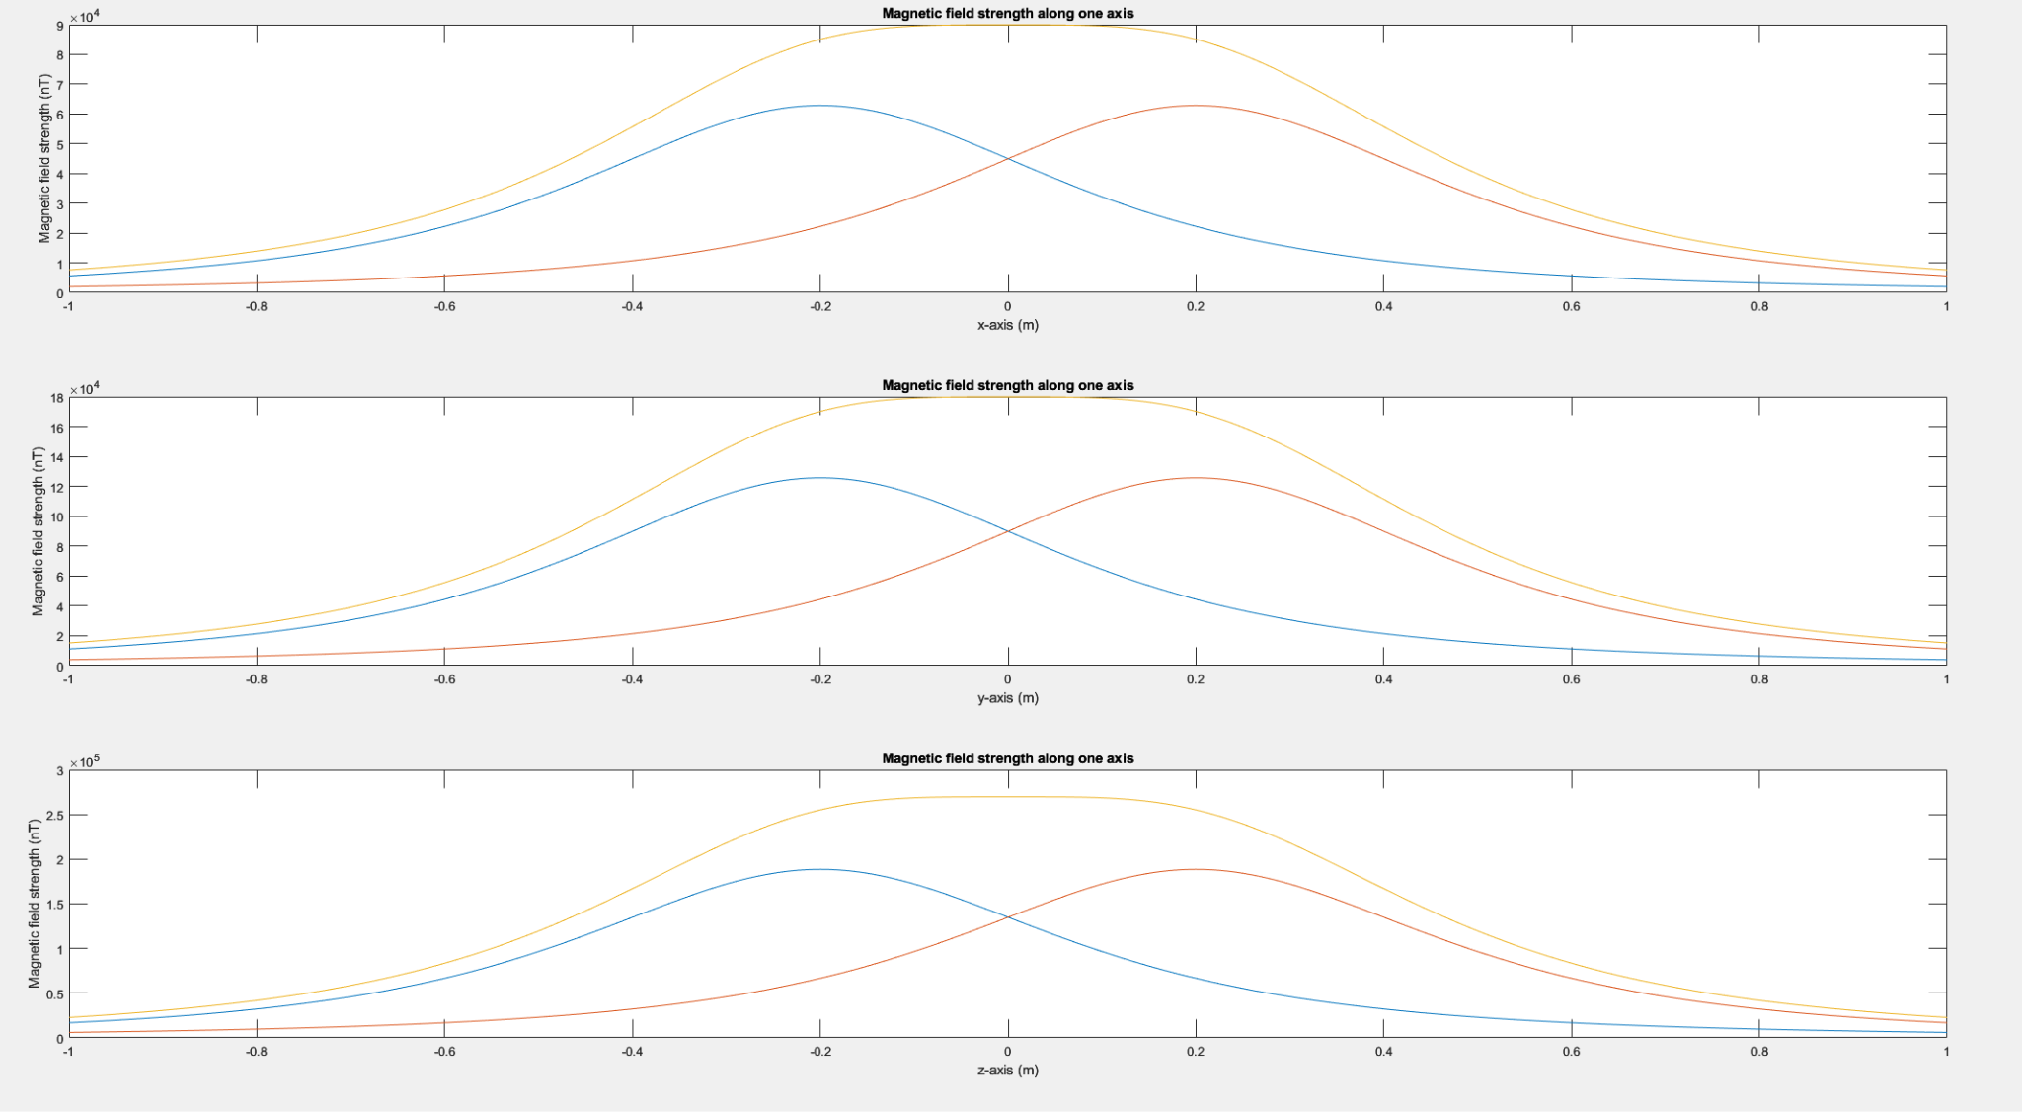
Weekly Quad Chart - 4/10
Updates
Blockers
Requirements
Crash course by Zac on MEKF
Pycubed board to start twiddling with software frameworks
Blockers and Requirements
Implemented a detumbling simulation with a BDot controller.
Magnetic field in 3-axis Helmholtz coils
Weekly Results
Solved wabhas problem with CVX, SVD, q-method and gauss newton method
Implemented a detumbling simulation with a BDot controller. Sim models translational and rotational kinematics and dynamics for the cubesat.
Finished the Helmholtz coil’s matlab simulation, which can give the magnetic field on 3-axis
Next week
Implement simple MEKF
Add sensor noise, bias, sensor filtering for sim
Weekly Results and Plan
Avionics:
Finalize computer framework and sensor selections
Mechanical:
Vision:
Discuss any major changes or updates to output of vision system
COMOPS:
Communication protocol & Commands
Interface dependencies

Slide 6
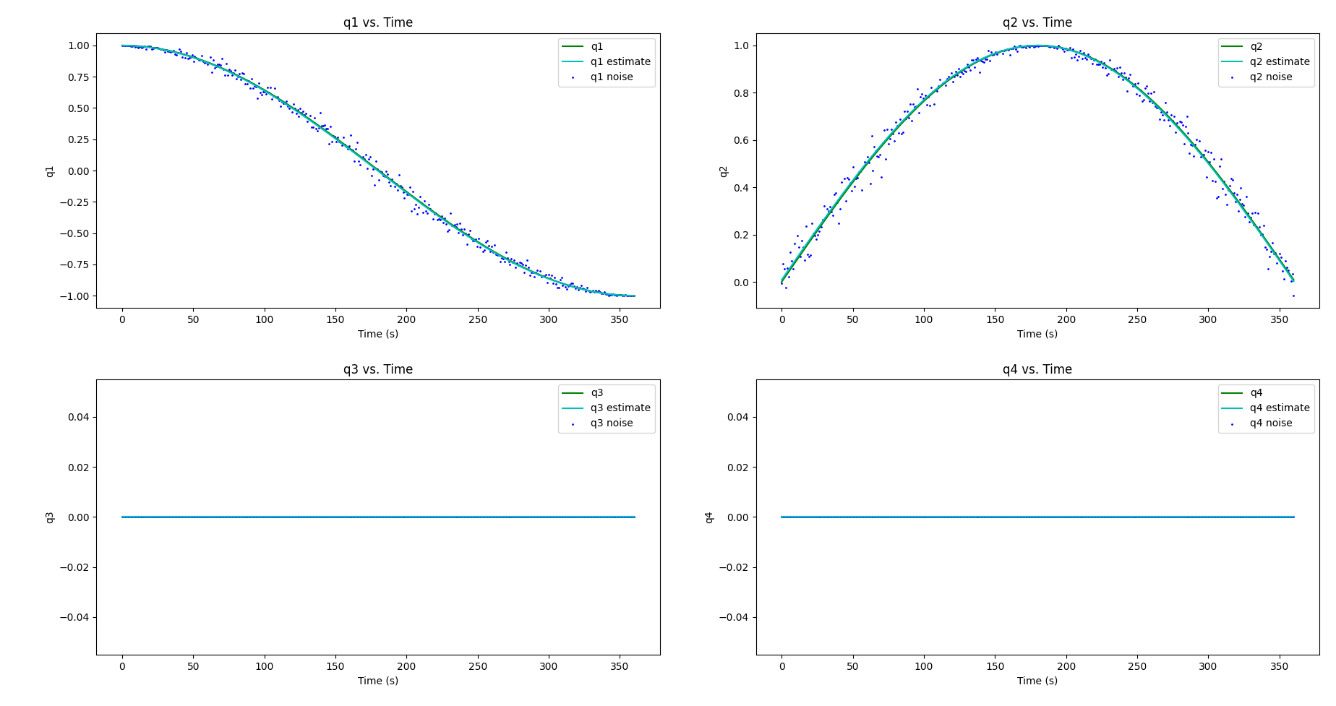
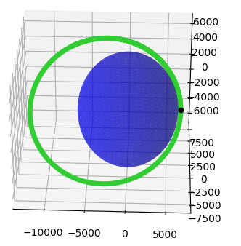
Weekly Quad Chart - 27/09
Updates
Blockers
Requirements
Crash course by Zac on MEKF
Pycubed board to start twiddling with software frameworks
Blockers and Requirements
Simple attitude determination in quaternions
Simulating orbit propagation with two-body dynamics
Weekly Results
Implemented simple EKF for attitude determination
Studied and implemented quaternion operations in python required for MEKF
Trade study between CircuitPython vs FPrime
Simulated orbit propagation with two-body dynamics
Studied HIL testing for magnetometer, magnetic torquer, and IMU
Next week
Study attitude determination course notes
Implement first version of attitude estimator
Start playing around with chosen architecture
Start designing the Helmholtz cage for HIL simulation
Weekly Results and Plan
Avionics:
Finalize computer framework and sensor selections
Mechanical:
Vision:
Discuss any major changes or updates to output of vision system
COMOPS:
Communication protocol & Commands
Interface dependencies

Slide 7
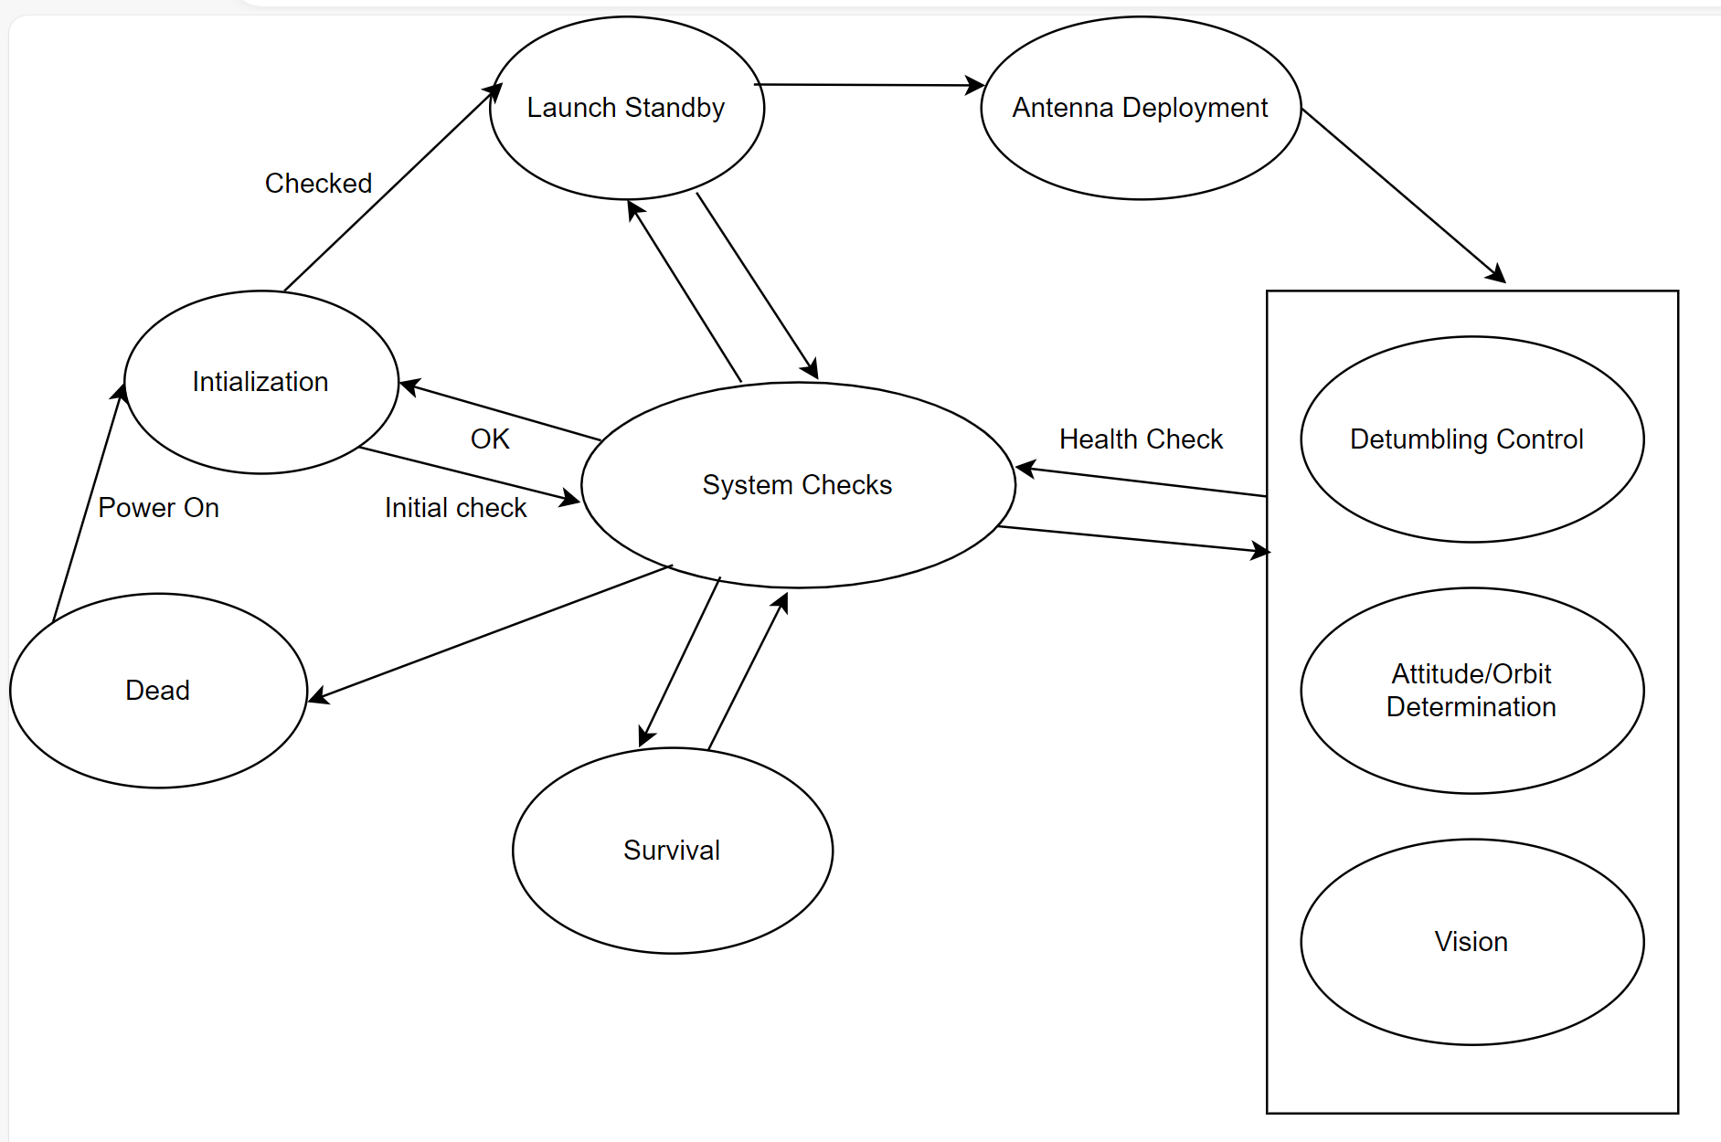
Weekly Quad Chart - 20/09
Updates
Blockers
Requirements
Recorded satellite sensor(sun,magnetometer) measurements
Crash Course by Zac
Blockers and Requirements
Figure: Basic state machine diagram
Weekly result
Studied resources on quaternions and MEKF
Initiated development on attitude estimation with basic quaternion operations
Developed basic state machine
First version of simulation for satellite position based on Newton’s law of gravity and RK4
Next week
Implement simple attitude estimator
Progress on subsystem interfaces
Meeting with Comms for functional partitioning and protocol
Meeting with Avionics for hardware choices
Iterate on State machine design and simulation
Weekly Results and Plan
Avionics:
Software framework/ baseline computer system
Kernel functionality
Sensors & Actuators drivers
Mechanical:
Mass estimate
Moment of inertia
Mechanical layout
Vision:
Discuss any major changes or updates to output of vision system
COMOPS:
Communication protocol & Commands
Interface dependencies

Slide 9
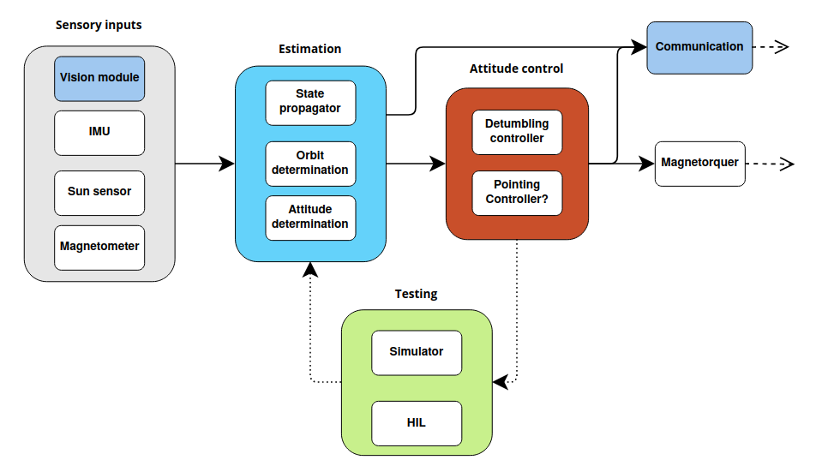
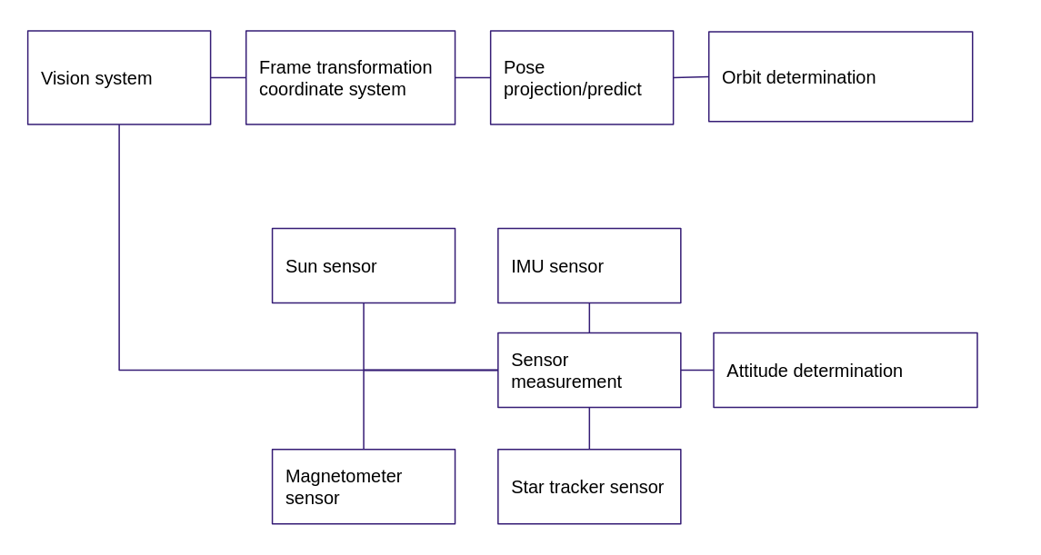
Weekly Quad Chart - 12/09
Updates
Blockers
Coming up with specific numbers in the requirements (sensors)
Lack of background in orbital and attitude dynamics (simulation,estimation,attitude control)
Requirements
None
Blockers and Requirements
First draft
Developed first draft of attitude and orbit determination architecture
Weekly result
Refined the level 2 requirements
Developed initial block diagram for estimation
Studied material about Kalman filter, spacecraft attitude determination and control system
Preliminary actuator and sensor selection
Next week
Develop milestone chart
Study resources given by Zac on attitude determination and (M)EKF
Start development of simple EKFs
Simulation rigid-body dynamics (2 body and attitude)
General flight software architecture
Design first draft of cyber physical architecture for estimation module
Create first draft of software design document for attitude control
Weekly Results and Plan
Avionics:
Software framework/ baseline computer system
Power budget?
Sensors & Actuators drivers
Mechanical:
Mass estimate
Moment of inertia
Mechanical layout
Vision:
Vision system output to finalise orbit and attitude determination design architecture. Set up meeting this week
COMOPS:
Type of antenna and influence on pointing requirement
Interface dependencies

